Slide 2
Objectives
Describe the need for multimedia in HTML5
List the supported media types in HTML5
Explain the audio elements in HTML5
Explain the video elements in HTML5
Explain the accessibility of audio and video elements
Describe how to deal with non-supporting browsers

Slide 3
Introduction
Traditionally, Web browsers were capable of handling only graphics and text.
User had to install a distinct program, plug-in, or an ActiveX control to play some video.
Earlier, Web designers and Web developers used to set up Web pages to play audio and video on the Web using Adobe Flash player.

Slide 4
Multimedia in HTML5
Multimedia is a combination of various elements such as video, graphics, sound, and text.
Common way of inserting a multimedia content on Web pages is by embedding a video or audio file in the Web page.
HTML5 has made lives easier by introducing <audio> and <video> elements.
HTML5 has provided the developers with the features to embed media on the Web pages in a standard manner.

Slide 5
Supported Media Types in Audio and Video
Following table lists the common audio and video formats:
There are various video and audio codecs which are used for handling of video and audio files.
Codec is a device or a program used for encoding and decoding digital data stream.
Different codecs have different level of compression quality.
For storing and transmitting coded video and audio together, a container format is used.
There are a number of container formats which includes Ogg (.ogv), the Audio Video Interleave (.avi), Flash Video (.flv), and many others.
Different browsers support different container format. WebM is a new open source video container format supported by Google.
^{Container} | ^{Video Codec} | ^{Audio Codec}
^{Mp4} | ^{H.264} | ^{AAC}
^{Ogg} | ^{Theora} | ^{Vorbis}
^{WebM} | ^{VP8} | ^{Vorbis}

Slide 6
Audio Formats
There are three supported file formats for the <audio> element in HTML5.
Following table lists the audio file formats supported by the Web browsers:
^{Browser Support} | ^{MP3} | ^{WAV} | ^{Ogg}
^{Opera 10.6} | ^{No} | ^{Yes} | ^{Yes}
^{Apple Safari 5} | ^{Yes} | ^{Yes} | ^{No}
^{Google Chrome 6} | ^{Yes} | ^{Yes} | ^{Yes}
^{FireFox 4.0} | ^{No} | ^{Yes} | ^{Yes}
^{Internet Explorer 9} | ^{Yes} | ^{No} | ^{No}

Slide 7
Video Formats
There are the three supported file formats for the <video> element in HTML5.
Following table lists the video file formats supported by the Web browsers:
^{Browser Support} | ^{MP3} | ^{WAV} | ^{Ogg}
^{Opera 10.6} | ^{No} | ^{Yes} | ^{Yes}
^{Apple Safari 5} | ^{Yes} | ^{No} | ^{No}
^{Google Chrome 6} | ^{Yes} | ^{Yes} | ^{Yes}
^{FireFox 4.0} | ^{No} | ^{Yes} | ^{Yes}
^{Internet Explorer 9} | ^{Yes} | ^{No} | ^{No}

Slide 8
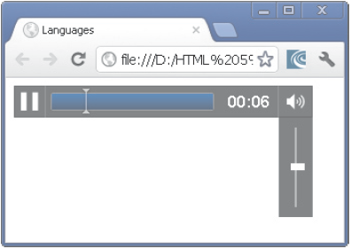
Audio Elements in HTML5
<audio> element will help the developer to embed music on the Web site.
<audio> tag specifies the audio file to be used in the HTML document.
src attribute is used to link the audio file.
The Code Snippet displays the embedding of an audio file in the Web page using the <audio> tag.
^{<!doctype html>}
^{<html>}
^{<head>}
^{<title>audio element</title>}
^{</head>}
^{<body>}
<audio src=”d:\sourcecodes\audio.mp3”
^{controls autoplay loop>}
^{html5 audio not supported}
^{</audio>}
^{</body>}
^{</html>}
Audio formats frequently used are wav, ogg, and mp3.

Slide 9
Audio Tag Attributes
Attributes provide additional information to the browser about the tag.
HTML5 has a number of attributes for controlling the look and feel of various functionalities.
HTML5 has the following attributes for the <audio> element.
Following table lists some of the <audio> tag attributes.
^{Audio Attributes} | ^{Description}
^{autoplay} | This attribute identifies whether to start or not the audio once the object is loaded
^{autobuffer} | This attribute starts the buffering automatically
^{controls} | This attribute identifies the audio playback controls that should be displayed such as resume, pause, play, and volume buttons
^{loop} | This attribute identifies whether to replay the audio once it has stopped
^{preload} | This attribute identifies whether the audio has to be loaded when the page loads and is ready to execute

Slide 10
Creating Audio Files
To play the audio in older browsers then the <embed> tag will be used.
<embed> tag has two attributes, src and autostart.
src attribute is used to specify the source of the audio.
autostart attribute controls the audio and determines whether the audio should play as soon as the page loads.
The Code Snippet demonstrates the use of <embed> tag in the <audio> element.
^{<!DOCTYPE HTML>}
^{<html>}
^{<body>}
^{<audio autoplay loop>}
^{<source src=”sampaudio.mp3”>}
^{<source src=”sampaudio.ogg”>}
^{<embed src=”sampaudio.mp3”>}
^{</audio>}
^{</body>}
^{</html>}

Slide 11
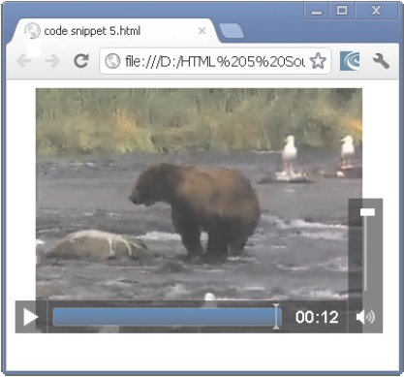
Video Elements in HTML5
<video> element is a new feature added in HTML5.
<video> element is for embedding the video content on the Web page.
<video> element if not supported by the browser then the content between the start tag and end tag is displayed.
src attribute is used to link to the video file.
The Code Snippet demonstrates the use of the <video> element.
^{<!DOCTYPE HTML>}
^{<html>}
^{<head>}
^{</head>}
^{<body>}
<video src=”D:\Source codes\movie.mp4”>
Your browser does not support the video.
^{</video>}
^{</body>}
^{</html>}

Slide 12
Video Tag Attributes
HTML5 specification provides a list of attributes that can be used with the <video> element.
HTML5 has the following attributes for the <video> element.
Following table lists some of the <video> tag attributes.
^{Video Attributes} | ^{Description}
^{autoplay} | Specifies that the browser will start playing the video as soon as it is ready
^{muted} | Allows to mute the video initially, if this attribute is existing
^{controls} | Allows displaying the controls of the video, if the attribute exists
^{loop} | Specifies that the browser should repeat playing the existing video once more if the loop attribute exists and accepts a boolean value
^{preload} | Specifies whether the video should be loaded or not when the page is loaded

Slide 13
Preloading the Video
<video> element comprises a preload attribute that allows the browser to download or buffering the video while the Web page containing the video is being downloaded.
preload attribute has the following values:
None - allows the browser to load only the page. The video will not be downloaded while the page is being loaded.
Metadata - allows the browser to load the metadata when the page is being loaded.
Auto - is the default behavior as it allows the browser to download the video when the page is loaded. The browser can avoid the request.

Slide 14
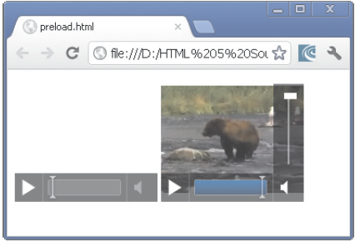
Video Elements in HTML5
The Code Snippet demonstrates the use of none and metadata values for the preload attribute.
^{<!DOCTYPE HTML>}
^{<html>}
^{<head>}
^{</head>}
^{<body>}
<video width=”160” height=”140” src=”D:\Source Codes\movie.mp4” controls preload=”none” muted>
Your browser does not support the video.
^{</video>}
<video width=”160” height=”140” src=”D:\ Source Codes\movie.mp4” controls preload=”metadata” muted>
Your browser does not support the video.
^{</video>}
^{</body>}
^{</html>}

Slide 15
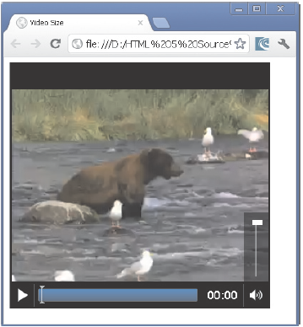
Setting the Video Size
User can specify the size of the video with the height and width attribute of the <video> element.
If these attributes are not provided then the browser sets the video with the key dimensions of the video.
The Code Snippet demonstrates how to apply the height and width attributes to the <video> element.
^{<!DOCTYPE HTML>}
^{<html>}
^{<head>}
^{</head>}
^{<title> Video Size</title>}
^{<style>}
^{video{}
^{background-color: black;}
^{border: medium double black;}
}
^{</style>}
^{<body>}
<video src=”D:\Source Codes\movie.mp4” controls preload=”auto” width=”360” height=”340”>
Your browser does not support the video.
^{</video>}
^{</body>}
^{</html>}

Slide 16
Converting the Video Files
There are many problems with browser vendors for supporting the various video formats on the Web sites.
Following are some of the video formats supported by the significant browsers:
Ogg/Theora - is an open source, royalty-free, and patent-free format available. This format is supported by browsers such as Opera, Chrome, and Firefox.
WebM - is a royalty-free and patent-free format supported by Google. This format is supported by browsers such as Opera, Chrome, and Firefox.
H.264/MP4 - are supported on iPhone and Google Android devices.
Micro Video Controller - converter creates all files that the user requires for HTML5 <video> element that works on the cross browser.

Slide 17
Accessibility of Audio and Video Elements 1-2
Enterprises across the world are employing people with varied skills and abilities.
It may include people with limited abilities or disabilities such as people with visual, cognitive, or mobility impairments.
Accessibility is the level of ease with which computers can be used and be available to a wide range of users.
While developing an application a lot of assumptions are to be considered and some of them are as follows:
Users can check the content on laptop, mobile, tablet, or desktop.
Users can listen to the audio by using headphones or speakers.
Users can understand the language in which the media was delivered.
Users can successfully play and download the media.

Slide 18
Accessibility of Audio and Video Elements 2-2
Earlier, assumptions made will meet the requirements of a vast majority of users accessing the application.
Not all users will fall in this category.
Another set of assumptions are to be considered for users and they are as follows:
Users who have hearing and visual impairment and thus, cannot listen to the audio or view the video.
Users who are not familiar with the language that the content is delivered.
Users who uses keyboards and screen readers to access the content on Web.
Users who cannot view or hear the media content because of their working environment or due to device restrictions.

Slide 19
Track Element 1-3
Track element provides an easy, standard way to add captions, subtitles, chapters, and screen reader descriptions to the <audio> and <video> elements.
Track elements are also used for other types of timed metadata.
Source data for this track element is in a form of a text file that is made up of a list of timed cues.
Cue is a pointer at an accurate time point in the length of a video.
Cues contain data in formats such as Comma-Separated Values (CSV) or JavaScript Object Notation.
Track element is not supported in many major browsers and is now available in IE 10 and Chrome 18+.

Slide 20
Track Element 2-3
Following table lists the track element attributes.
^{Container} | ^{Description}
^{src} | Contains the URL of the text track data
^{srclang} | Contains the language of the text track data
^{kind} | Contains the type of content for which the track definition is used
^{default} | Indicates that this will be the default track if the user does not specifies the value
^{label} | Specifies the title to be displayed for the user

Slide 21
Track Element 3-3
The Code Snippet demonstrates how a track element is used in combination with <video> element for providing subtitles.
^{<video controls>}
<source src=”myvideo.mp4” type=”video/mp4” />
<source src=”myvideo.webm” type=”video/webm” />
<track src=”eng.vtt” label=”English subtitles” kind=”subtitles” srclang=”en” >
^{</video>}
The Code Snippet demonstrates how a track element is used in combination with <video> element providing subtitles in another language.
^{<video controls>}
<source src=”myvideo.mp4” type=”video/mp4” />
<source src=”myvideo.webm” type=”video/webm” />
<track src=”de.vtt” label=”German subtitles” kind=”subtitles” srclang=”de” >
^{</video>}

Slide 22
Accessibility for Audio and Video Element
Accessibility supports for <audio> and <video> elements are as follows:
^{Audio Support}
Firefox - Expose controls with accessibility APIs, however individual controls do not interact with keyboard. Access to keyboard is provided by the Firefox specific shortcuts.
Opera - Has only keyboard support.
IE 9 - Expose controls with accessibility APIs, however individual controls do not interact with keyboard.
^{Video Support}
Firefox - Cannot interact with individual controls.
Opera - Has only keyboard support.
IE 9 - Does not allow individual controls to interact with keyboard.

Slide 23
Summary
Multimedia is a combination of various elements such as video, graphics, sound, and text.
There are various media types used for audio and video files on different Web sites.
The <audio> element will help the developer to embed music on the Web site and allow the user to listen to music.
Users can play the audio in older browsers using the <embed> tag.
The <video> element is used for embedding the video content on the Web page.
Preload attribute identifies whether the audio has to be loaded when the page loads and is ready to execute.
WebM is a new open source video container format supported by Google.

